Slide 1
4.1 Types of software and interrupts
Relationship between hardware, firmware and operating systems

Slide 2
Software and hardware
The relationship between software and hardware
…application software…
…talks to the operating system….
…which then interacts with…
…hardware, which talks back to…
…the operating system…
…which talks back to the…
Application software
Operating system
Hardware

Slide 3
Software and hardware
The relationship between software and hardware
…application software…
…talks to the operating system….
…which then interacts with…
…hardware, which talks back to…
…the operating system…
…which talks back to the…
Application software
Operating system
Hardware

Slide 4
Software and hardware
The relationship between software and hardware
…application software…
…talks to the operating system….
…which then interacts with…
…hardware, which talks back to…
…the operating system…
…which talks back to the…
Application software
Operating system
Hardware

Slide 5
Software and hardware
The relationship between software and hardware
…application software…
…talks to the operating system….
…which then interacts with…
…hardware, which talks back to…
…the operating system…
…which talks back to the…
Application software
Operating system
Hardware

Slide 6
Software and hardware
The relationship between software and hardware
…application software…
…talks to the operating system….
…which then interacts with…
…hardware, which talks back to…
…the operating system…
…which talks back to the…
Application software
Operating system
Hardware

Slide 7
Software and hardware
The relationship between software and hardware
…application software…
…talks to the operating system….
…which then interacts with…
…hardware, which talks back to…
…the operating system…
…which talks back to the…
Application software
Operating system
Hardware

Slide 8
Software and hardware
The relationship between software and hardware
…application software…
…talks to the operating system….
…which then interacts with…
…hardware, which talks back to…
…the operating system…
…which talks back to the…
Application software
Operating system
Hardware

Slide 9
Software and hardware
The relationship between software and hardware
…application software…
…talks to the operating system….
…which then interacts with…
…hardware, which talks back to…
…the operating system…
…which talks back to the…
Application software
Operating system
Hardware

Slide 10

Software and hardware
The relationship between software and hardware
…application software…
…talks to the operating system….
…which then interacts with…
…hardware, which talks back to…
…the operating system…
…which talks back to the…
Application software
Operating system
Hardware

Slide 11
Firmware
When a computer first loads up, it looks to the ROM for its initial boot-up instructions. These are contained in a program called the:
Bootstrap
Bootstrap loader
Bootloader
This initial process is handled by the basic input/output system (BIOS), also referred to as firmware – this sits between the operating system and the hardware and provides low-level control for devices.
Application software
Operating system
Firmware
(Bootloader/BIOS)
Hardware

Slide 12

Hardware, firmware and the operating system
Applications are run on the operating system.
The operating system is run on firmware.
The bootloader (firmware) is run on the hardware.
The bootloader is located in ROM (non-volatile) storage and is one of the first programs loaded into memory when a computer is turned on.
You can think of this like a hierarchy with the user at the top and hardware at the bottom:
User ➔ Application software ➔ Operating system ➔ Firmware ➔ Hardware

Slide 13

4.1 Types of software and interrupts
Going beyond the IGCSE specification

Slide 14



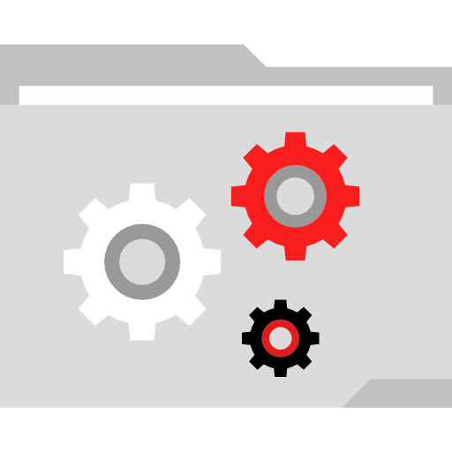
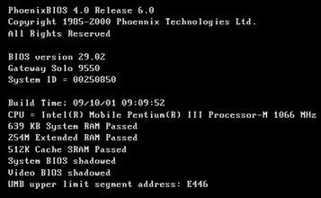
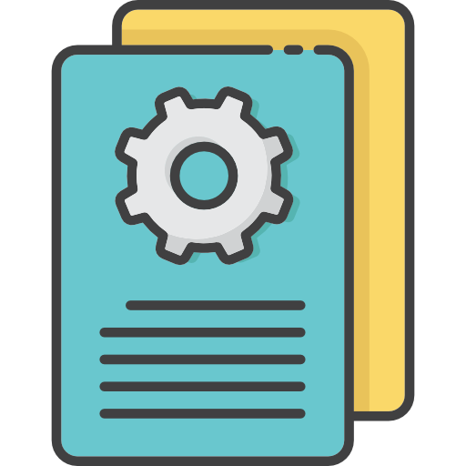
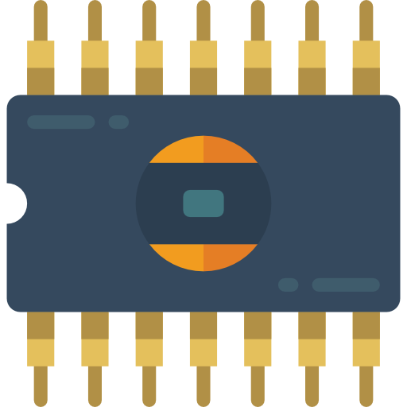
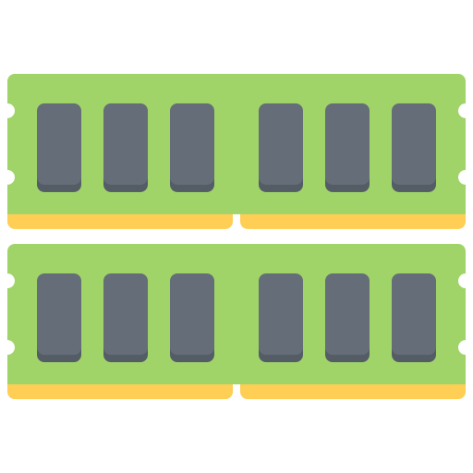
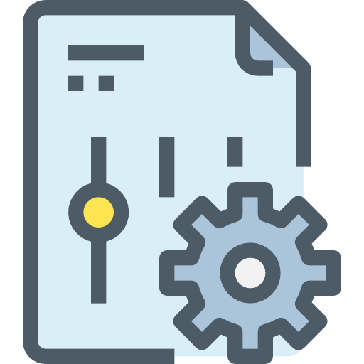
Powering on your computer
The OS now takes control of the computer and memory and will load jobs into the memory for processing as per the rules of the scheduler.
Power turned on
Control is passed to the bootloader program (bootstrap), which carries out checks on the hardware.
Checks for any BIOS on the hard disk or a storage device called CMOS RAM.
Then the OS looks for a file called COMMAND.COM, which contains more info about BIOS and OS utilities.
Only data from
ROM can be used
at this point.
The OS now searches for files like CONFIG.SYS, which will tell it how many files can be open at a time and which device drivers to load.
Loads the address of the first instruction in the boot program into the program counter.
The OS is normally found on the hard disk, but the computer’s BIOS settings can be changed to check other drives first.
Combines this with the basic BIOS stored on the ROM and then sends it to RAM.
This file of information is called the boot file.
Clears anything that may still be in the registers of the CPU.
POST (power-on self-test) checks that all required components are present and available.
The computer is now ready to load the OS.

Slide 15
The evolution of ROM
All types are non-volatile. All data is either:
Unchangeable (read-only).
Changeable but requires a special operation to do so.
ROM | PROM | EPROM | EEPROM
Read-only memory | Programmable read-only memory | Erasable programmable read-only memory | Electrically erasable programmable read-only memory
Programming of data must be complete when the chip is created. Cannot be reprogrammed or rewritten. |  |  | The chip does not have to be removed to be rewritten. The entire chip doesn’t need to be completely erased to change a specific portion of it. Changing contents doesn’t require specialist equipment.

Slide 16
The evolution of ROM
All types are non-volatile. All data is either:
Unchangeable (read-only).
Changeable but requires a special operation to do so.
ROM | PROM | EPROM | EEPROM
Read-only memory | Programmable read-only memory | Erasable programmable read-only memory | Electrically erasable programmable read-only memory
Programming of data must be complete when the chip is created. Cannot be reprogrammed or rewritten. | Blank when initially manufactured. Can be purchased and coded once with a special tool known as a programmer – known as burning the PROM. |  | The chip does not have to be removed to be rewritten. The entire chip doesn’t need to be completely erased to change a specific portion of it. Changing contents doesn’t require specialist equipment.

Slide 17
The evolution of ROM
All types are non-volatile. All data is either:
Unchangeable (read-only).
Changeable but requires a special operation to do so.
ROM | PROM | EPROM | EEPROM
Read-only memory | Programmable read-only memory | Erasable programmable read-only memory | Electrically erasable programmable read-only memory
Programming of data must be complete when the chip is created. Cannot be reprogrammed or rewritten. | Blank when initially manufactured. Can be purchased and coded once with a special tool known as a programmer – known as burning the PROM. | Can be rewritten many times. Erasing requires a special tool that emits a certain frequency of UV light. Must be removed from a device before it can be erased and reprogrammed. | The chip does not have to be removed to be rewritten. The entire chip doesn’t need to be completely erased to change a specific portion of it. Changing contents doesn’t require specialist equipment.

Slide 18
The evolution of ROM
All types are non-volatile. All data is either:
Unchangeable (read-only).
Changeable but requires a special operation to do so.
ROM | PROM | EPROM | EEPROM
Read-only memory | Programmable read-only memory | Erasable programmable read-only memory | Electrically erasable programmable read-only memory
Programming of data must be complete when the chip is created. Cannot be reprogrammed or rewritten. | Blank when initially manufactured. Can be purchased and coded once with a special tool known as a programmer – known as burning the PROM. | Can be rewritten many times. Erasing requires a special tool that emits a certain frequency of UV light. Must be removed from a device before it can be erased and reprogrammed. | The chip does not have to be removed to be rewritten. The entire chip does not need to be completely erased to change a specific portion of it. Changing contents does not require specialist equipment.

Slide 19


